Slide 1
Chapter 4: Geocentric models
A.K.A. Linear regression as a Bayesian model

Slide 2
Normal/Gaussian distributions
Innately linked to linear regression as a measure of uncertainty
Normal distributions arise naturally when we add up a large number of small probabilistic events, regardless of the underlying distribution of each individual event
1st rush
2nd rush
3rd rush
+
+
+ …
~
Total rushing distance over n rushes

Slide 3
How do we transcribe the models?
Data: observable variables, defined in terms of unobservable variables through a likelihood function
Parameters: unobservable variables, either assigned priors (stochastic/~) or defined in terms of other parameters (deterministic/=)

Slide 4
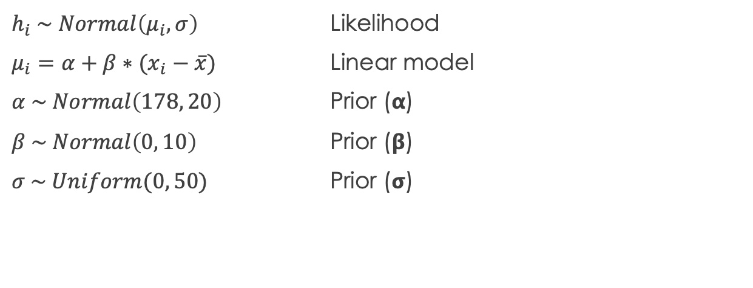
Linear model of height (p.96)
$h_{i} \sim Normal\left(μ_{i},σ\right)$ Likelihood
$μ_{i}=α+β∗(x_{i}−\overline{x})$ Linear model
$α \sim Normal\left(178, 20\right)$ Prior (𝝰)
$β \sim Normal\left(0, 10\right)$ Prior (𝝱)
$σ \sim Uniform(0, 50)$ Prior (𝞂)

Slide 5
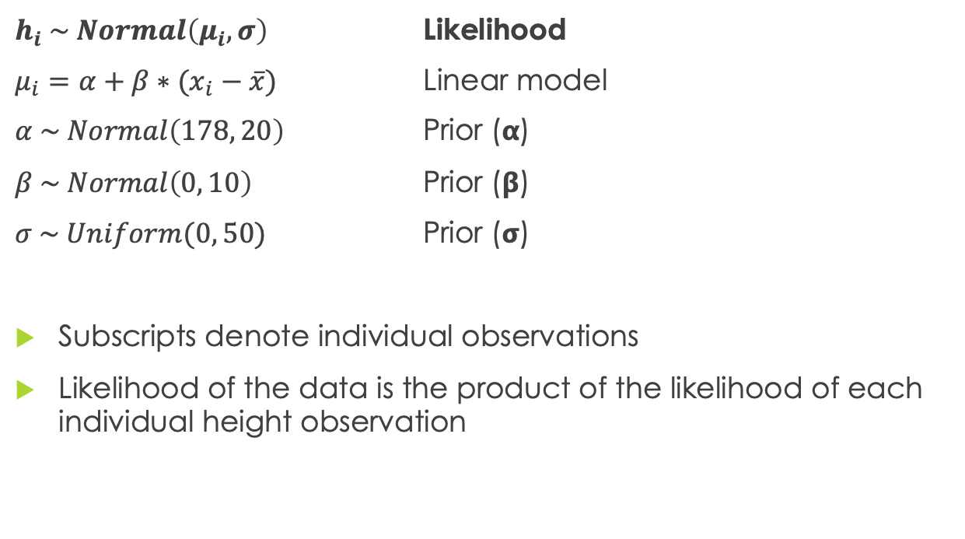
Linear model of height (p.96)
$h_{i} \sim Normal\left(μ_{i},σ\right)$ Likelihood
$μ_{i}=α+β∗(x_{i}−\overline{x})$ Linear model
$α \sim Normal\left(178, 20\right)$ Prior (𝝰)
$β \sim Normal\left(0, 10\right)$ Prior (𝝱)
$σ \sim Uniform(0, 50)$ Prior (𝞂)
Subscripts denote individual observations
Likelihood of the data is the product of the likelihood of each individual height observation

Slide 6
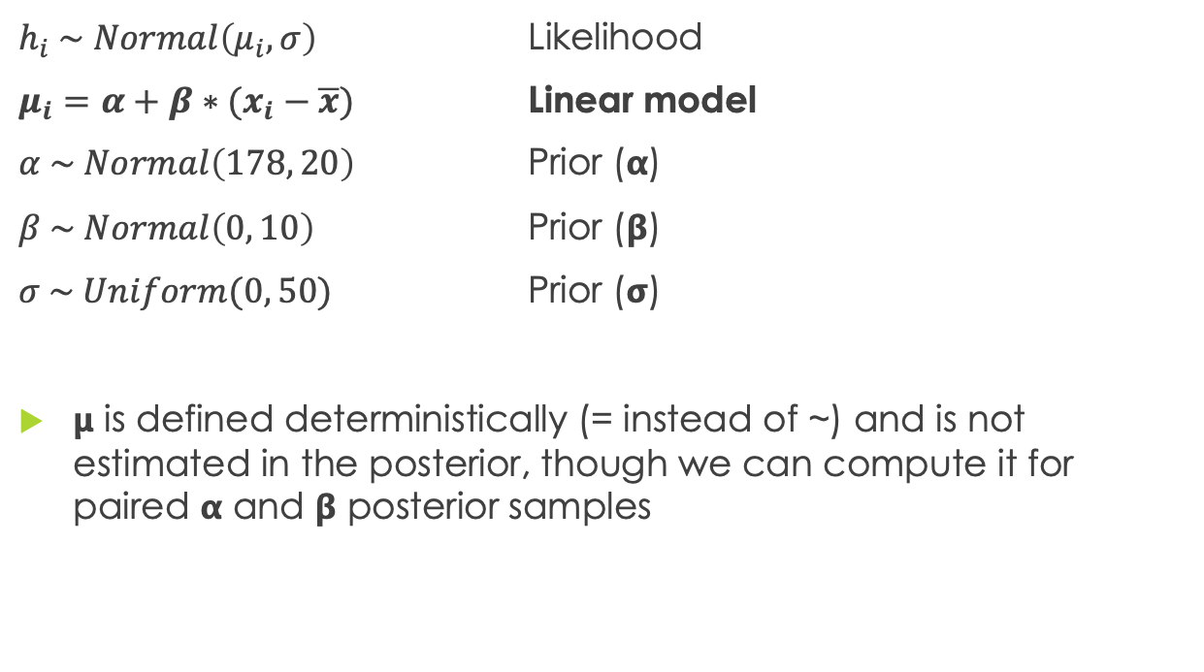
Linear model of height (p.96)
$h_{i} \sim Normal\left(μ_{i},σ\right)$ Likelihood
$μ_{i}=α+β∗(x_{i}−\overline{x})$ Linear model
$α \sim Normal\left(178, 20\right)$ Prior (𝝰)
$β \sim Normal\left(0, 10\right)$ Prior (𝝱)
$σ \sim Uniform(0, 50)$ Prior (𝞂)
𝝻 is defined deterministically (= instead of ~) and is not estimated in the posterior, though we can compute it for paired 𝝰 and 𝝱 posterior samples

Slide 7
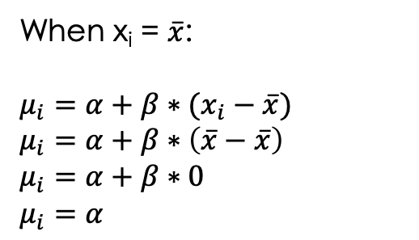
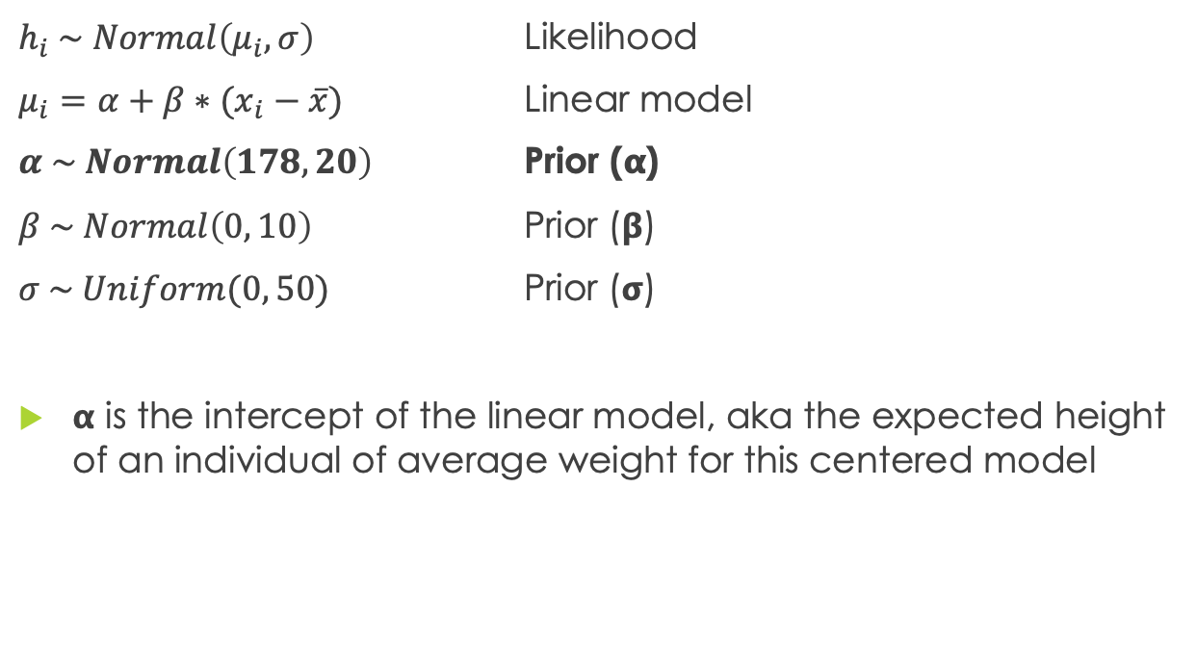
Linear model of height (p.96)
$h_{i} \sim Normal\left(μ_{i},σ\right)$ Likelihood
$μ_{i}=α+β∗(x_{i}−\overline{x})$ Linear model
$α \sim Normal\left(178, 20\right)$ Prior (𝝰)
$β \sim Normal\left(0, 10\right)$ Prior (𝝱)
$σ \sim Uniform(0, 50)$ Prior (𝞂)
𝝰 is the intercept of the linear model, aka the expected height of an individual of average weight for this centered model
When x_{i} = $\overline{x}$:
$μ_{i}=α+β∗(x_{i}−\overline{x})$
$μ_{i}=α+β∗\left(\overline{x}−\overline{x}\right)$
$μ_{i}=α+β∗0$
$μ_{i}=α$

Slide 8
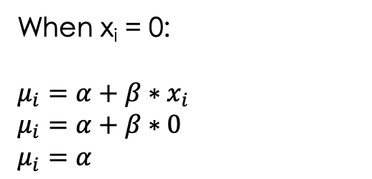
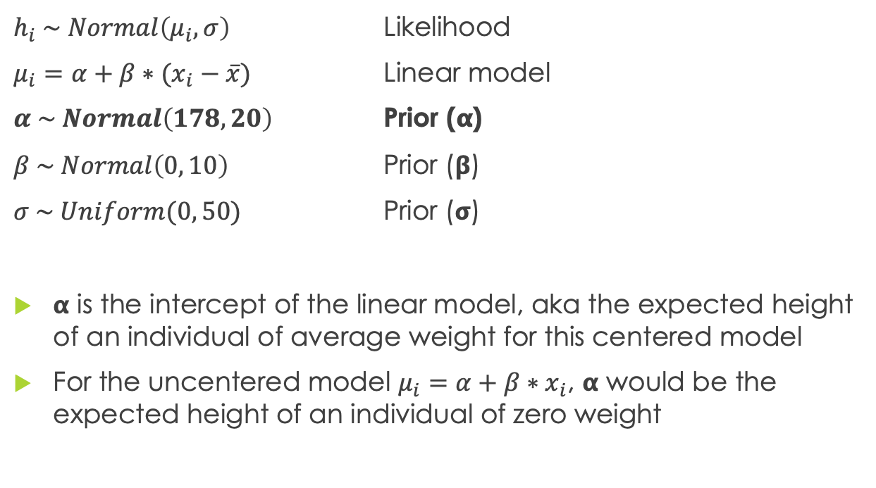
Linear model of height (p.96)
$h_{i} \sim Normal\left(μ_{i},σ\right)$ Likelihood
$μ_{i}=α+β∗(x_{i}−\overline{x})$ Linear model
$α \sim Normal\left(178, 20\right)$ Prior (𝝰)
$β \sim Normal\left(0, 10\right)$ Prior (𝝱)
$σ \sim Uniform(0, 50)$ Prior (𝞂)
𝝰 is the intercept of the linear model, aka the expected height of an individual of average weight for this centered model
For the uncentered model $μ_{i}=α+β∗x_{i}$, 𝝰 would be the expected height of an individual of zero weight
When x_{i} = 0:
$μ_{i}=α+β∗x_{i}$
$μ_{i}=α+β∗0$
$μ_{i}=α$

Slide 9
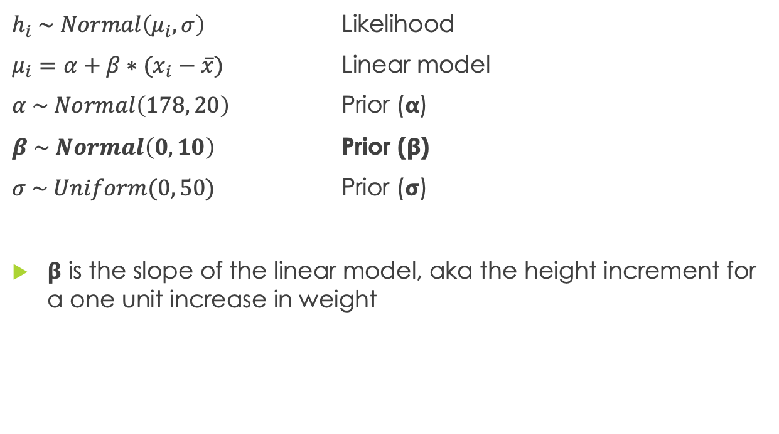
Linear model of height (p.96)
$h_{i} \sim Normal\left(μ_{i},σ\right)$ Likelihood
$μ_{i}=α+β∗(x_{i}−\overline{x})$ Linear model
$α \sim Normal\left(178, 20\right)$ Prior (𝝰)
$β \sim Normal\left(0, 10\right)$ Prior (𝝱)
$σ \sim Uniform(0, 50)$ Prior (𝞂)
𝝱 is the slope of the linear model, aka the height increment for a one unit increase in weight

Slide 10
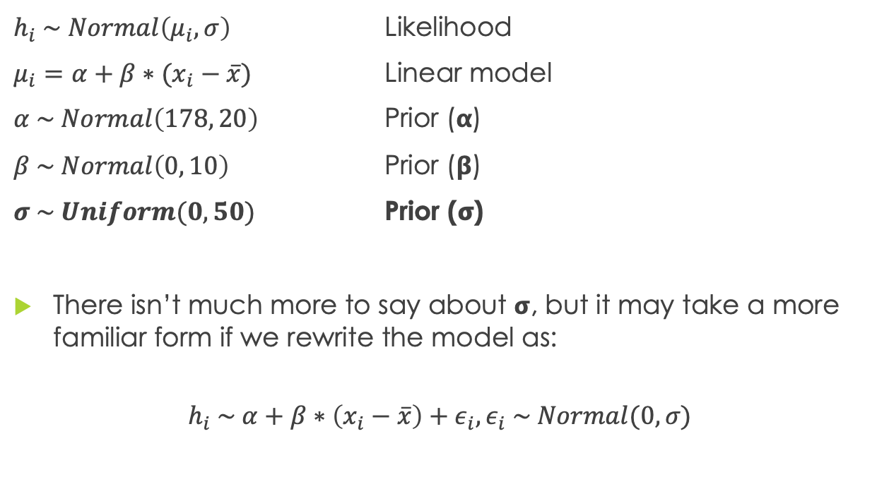
Linear model of height (p.96)
$h_{i} \sim Normal\left(μ_{i},σ\right)$ Likelihood
$μ_{i}=α+β∗(x_{i}−\overline{x})$ Linear model
$α \sim Normal\left(178, 20\right)$ Prior (𝝰)
$β \sim Normal\left(0, 10\right)$ Prior (𝝱)
$σ \sim Uniform(0, 50)$ Prior (𝞂)
There isn’t much more to say about 𝞂, but it may take a more familiar form if we rewrite the model as:
$$h_{i} \sim α+β∗\left(x_{i}−\overline{x}\right)+ε_{i}, ε_{i} \sim Normal(0, σ)$$

Slide 11
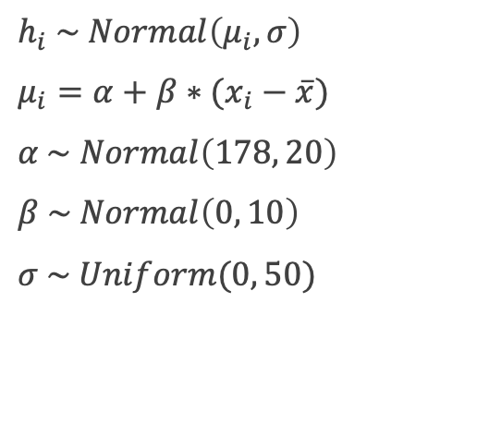
How do we analyze the models?
The quap (quadratic approximation) function estimates the posterior distributions for our model
Translate the model line-by-line into R code within an alist data structure:
m <- quap(alist(
height ~ dnorm(𝝻, 𝞂),
𝝻 <- 𝝰 + 𝝱 * (weight – mean_weight),
𝝰 ~ dnorm(178, 20),
𝝱 ~ dnorm(0, 10),
𝞂 ~ dunif(0, 50)
),
data = insertDataHere)
$h_{i} \sim Normal\left(μ_{i},σ\right)$
$μ_{i}=α+β∗(x_{i}−\overline{x})$
$α \sim Normal\left(178, 20\right)$
$β \sim Normal\left(0, 10\right)$
$σ \sim Uniform(0, 50)$

Slide 12
How do we analyze the models?
The precis function gives us estimates (mean, standard deviation) for the parameters in the posterior
We can also generate samples from the quap result, which give us the power to do many further computations
apply function: calculate mean (or other function) across samples
PI/HPDI: compute intervals across samples
link: generate posterior for 𝝻 based on samples
sim: generate height values with uncertainty (𝞂) based on the likelihood function
The interior workings of each of these functions are quite simple, and there is much more that we can do using our own code to manipulate the samples

